Slide 1
Practical Lessons
for
Leading

Slide 2
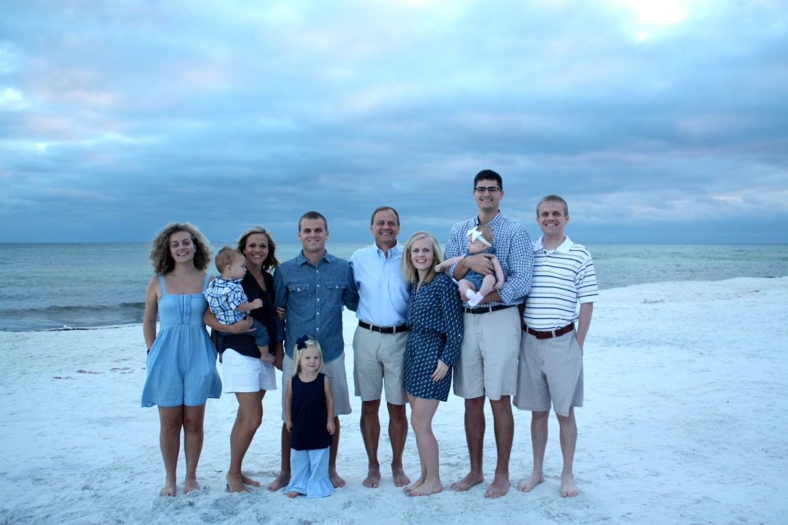
Family

Slide 3
Background
Over 35 years in Consumer Goods industry
Products — Charmin, Bounty, Jif, Folgers,
Dunkin Donuts, Cafe Bustelo, etc.
Involved with many acquisitions
Now retired and volunteer time to invest in others

Slide 4
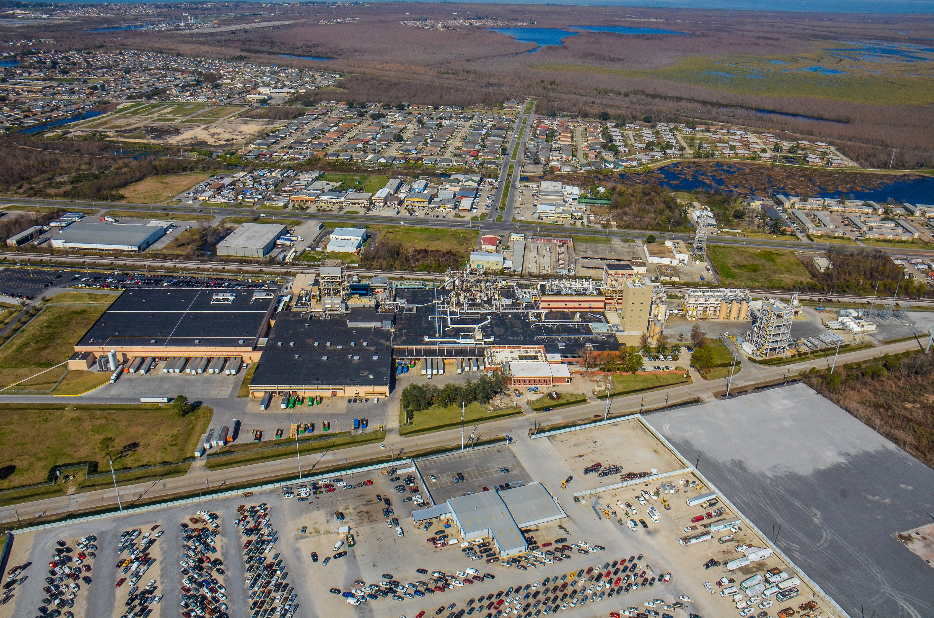
World’s Largest Coffee Plant

Slide 5
The Problem
Results vary and not sustainable.
Workforce not engaged.
Organization focus is not clear.
Low trust exists and there is a lack of fun in the work place.
People in your organization are not growing and developing.
You, as the leader, are not happy or fulfilled.

Slide 6
Leadership Principles

Slide 7
Leaders are PRINCIPLED
Never sacrifice your integrity.
Stand for what is right and ethical.
Be consistent in public and private.
YOU set the example.

Slide 8
Leaders are clear on their PURPOSE
“Love what you do. Do what you love.”
Are focused and consistent every day.
Are clear on goals and can share their importance with others.
Have contagious enthusiasm.

Slide 9
Leaders invest in PEOPLE
Serve others….
Listen. Engage. Involve others.
Learn about their lives. Care.
Look for the good in others. Encourage.
Cultivate this habit.

Slide 10
Leaders have a clear PLAN
Have a clear plan to deliver your goals.
Involve others.
Do the plan.
Check your progress.
Be flexible and adjust as needed.

Slide 11
Leaders are POSITIVE
Stay positive even in adversity.
Do not place blame, gossip, or criticize.
Have an attitude of “We will figure it out.”
Show and have faith in their team.

Slide 12
Leaders are clear on their PRIORITIES
Have fun! Laugh. Celebrate.
Keep the right perspective on what is
important.
My faith is most important and then my family.
Your life will stay balanced and you will do a
better job.

Slide 13
Principled
Purpose
People
Plan
Positive
Priorities

Slide 14
THANK YOU!!

