Slide 1
DASH

Slide 2
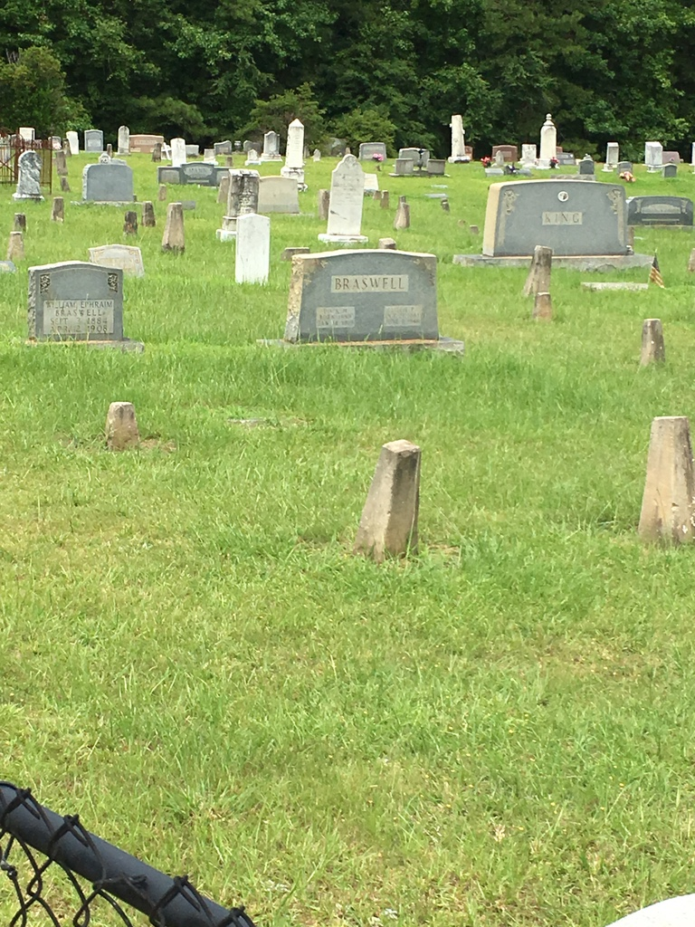
2000 — ???

Slide 3
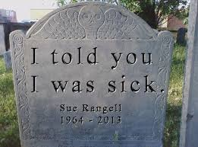

Slide 4
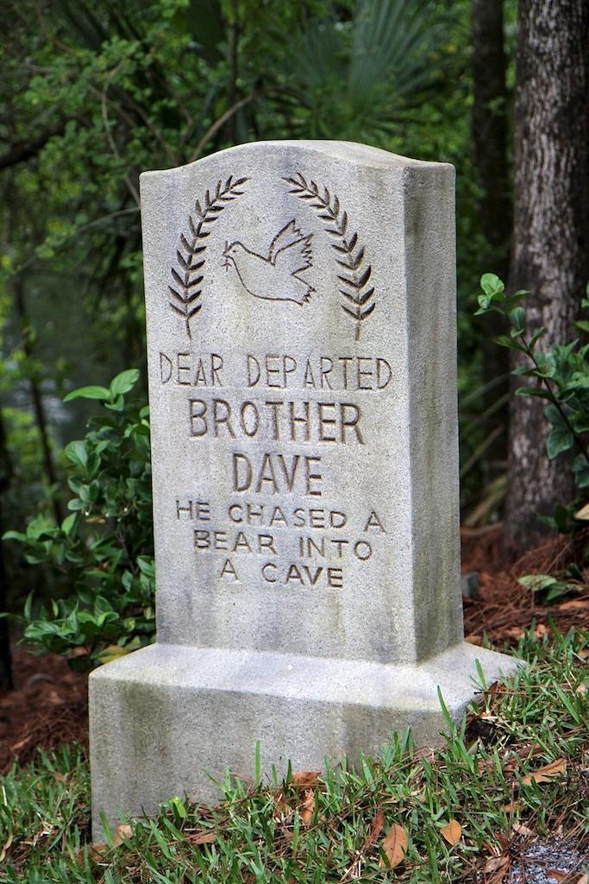

Slide 5
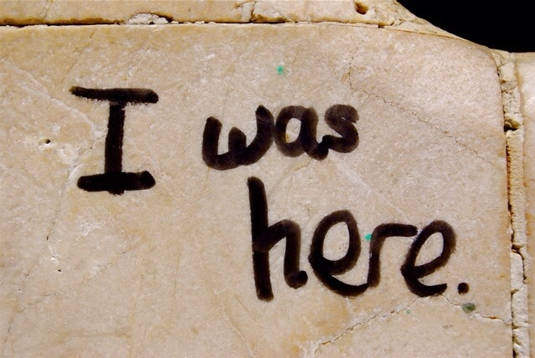

Slide 6
DASHOLOGY 101

Slide 7
January 21, 1933 — September 8, 2009
March 16, 1957 — December 25, 2010
June 6, 1956 — December 27, 2013
December 22, 1933 — June 12, 2019

Slide 8
Dashology 101
What About MY Dash?

Slide 9
Dashology 101
1. Some dashes are shorter than others and the end can
happen abruptly and unexpectedly.

Slide 10
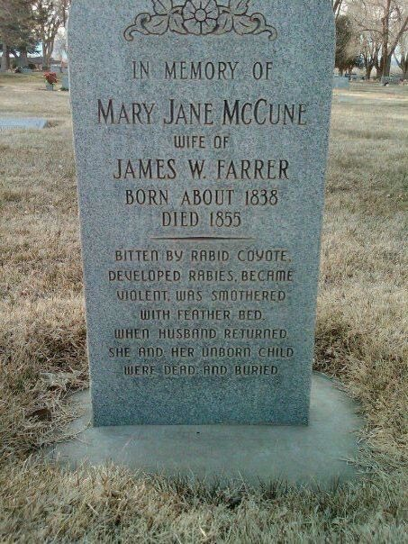

Slide 11
Dashology 101
1. Some dashes are shorter than others and the end can
happen abruptly and unexpectedly.
“Moreover, man does not know his time…….
when it suddenly falls on them.” Eccl. 9:12

Slide 12
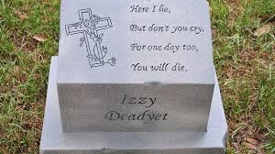
Dashology 101
2. Dashes occur without prejudice.

Slide 13
Dashology 101
2. Dashes occur without prejudice.
“And inasmuch as it is appointed for men to die once and after this comes judgment,” Heb. 9:27
“For as in Adam all die, ..” 1 Cor. 15:22

Slide 14
Dashology 101
3. Dashes do not mean that life is over and there
is no future.

Slide 15
Dashology 101
3. Dashes do not mean that life ends and there
is no future.
“These will go away into eternal punishment, but the righteous into eternal life.”
Matt. 25:46

Slide 16
Dashology 101
4. Eternal life in heaven, real life, is a result of being made righteous.

Slide 17
Dashology 101
4. Eternal life heaven, real life, is a result of being made righteous.
“as it is written: : ‘There is none righteous, not even one;’ Rom. 3:10

Slide 18
Dashology 101
4. Eternal life heaven, real life, is a result of being made righteous.
“as it is written: : ‘There is none righteous, not even one;’ Rom. 3:10
“He made Him who knew no sin to be sin on our behalf, so that we might become the righteousness of God in Him.” 2 Cor. 5:21

Slide 19
I must recognize my need for Jesus.

Slide 20
Dashology 101
5. Every dash tells a story.

Slide 21
Dashology 101
5. Every dash tells a story.
What will be your story?

Slide 22
Dashology 101
5. Every dash tells a story.
What will be your story?
“For by grace you have been saved through faith; and that not
of yourselves, it is the gift of God; not as a result of works,
so that no one my boast.” Eph. 2:8-9

Slide 23
Dashology 101
5. Every dash tells a story.
What will be your story?
“But you, be sober in all things, endure hardship, do the work of an evangelist, fulfill your ministry. For I am already being poured out as a drink offering, and the time of my departure has come. I have fought the good fight, I have finished the course, I have kept the faith;” 2 Timothy 4:5-7

Slide 24
Dashology 101
What will be your story?
Stand for Him no matter what others think.

Slide 25
Dashology 101
What will be your story?
Stand for Him no matter what others think.
Share the message of salvation through Jesus with others.

Slide 26
Dashology 101
What will be your story?
Stand for Him no matter what others think.
Share the message of salvation through Jesus with others.
Live for Him with all you have for all of your life.

Slide 27
Dashology 101
5. Every dash tells a story.
What will be your story?

Slide 28

Dashology 101
5. Every dash tells a story.
What will be your story?
www.counselfortoday.com

